Slide 1
RESUME PARSER
GE19612 - PROFESSIONAL READINESS FOR INNOVATION, EMPLOYABILITY AND ENTREPRENEURSHIP
Akshay Karthick A 210701322,
Selestin Vincent Raj S 210701228,
Kaja Mohideen P 210701514
Computer Science and Engineering.

Slide 2
ABSTRACT
The Resume Parser project utilizes advanced algorithms and NLP to automate the extraction of key details (personal information, skills, education, and work experience) from resumes. This automation aims to revolutionize the manual and error-prone process of resume screening, significantly enhancing efficiency in HR departments.A core objective is to reduce errors and ensure consistency in the screening process. By leveraging sophisticated algorithms, the system minimizes inaccuracies in parsing candidate information, leading to improved data quality and a more reliable recruitment process The project is designed for scalability, capable of handling large volumes of resumes. It employs NLP for nuanced keyword and context analysis, allowing the system to understand the meaning and relevance of terms within resumes. This scalability and contextual understanding provide a streamlined solution for parsing and categorizing candidate information with speed and precision, offering a significant advancement in recruitment processes.

Slide 3
OBJECTIVE
Implement a comprehensive automated parsing system that operates autonomously, eliminating the need for manual intervention in the resume screening process, thereby improving efficiency and reducing manual labor.
Develop parsing algorithms that ensure accurate extraction of pertinent details from resumes, including personal information, skills, education, and work experience, enhancing precision in candidate evaluation.
Create a parser that can adeptly handle various resume formats and structures, ensuring compatibility and effectiveness across a diverse range of job applications.

Slide 4
EXISTING SYSTEM
The existing manual resume screening process is time-consuming, error-prone, and demands significant human resources for candidate evaluation.
The Resume Parser revolutionizes this by implementing an automated system, eliminating manual intervention, enhancing efficiency, and reducing labor requirements.
Through advanced parsing algorithms, it ensures accurate extraction of vital candidate information, addressing the precision shortcomings of the traditional manual screening approach.

Slide 5
PROPOSED SYSTEM
Automated Information Extraction: The system will automatically extract key information from resumes, including but not limited to contact details, educational background, work experience, and skills.
Customizable Criteria: Users can define specific criteria and keywords relevant to the job opening, tailoring the parser to the unique requirements of each position.
Integration Capabilities: Seamless integration with existing Applicant Tracking Systems (ATS) to streamline the entire recruitment workflow.
Data Security Measures: Robust encryption and data protection measures to ensure compliance with privacy regulations and safeguard sensitive candidate information.

Slide 6
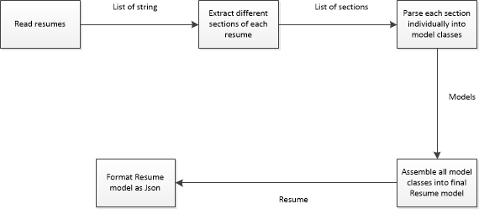
SYSTEM ARCHITECTURE

Slide 7
SOFTWARE USED
Web Development
Flask: Manages HTTP requests and responses.
J inja2: Renders HTML templates.
File Handling
os: Manages directories and file paths.
Text Extraction
pdfminer.six: Extracts text from PDF files.
Natural Language Processing (NLP)
spaCy: Processes and analyzes text.
Model: en_core_web_sm for NLP tasks.
Regular Expressions
re: Defines patterns to extract phone numbers and emails.

Slide 8
PROBLEM STATEMENT
Manual resume screening processes are time-consuming, error-prone, and resource-intensive, leading to delays, inaccuracies, and increased operational costs in the recruitment workflow.
The inefficiencies in existing resume screening methods necessitate a solution to automate and streamline the extraction of crucial candidate information, addressing the challenges of manual intervention, inaccuracies, and resource drain.
The need for an automated resume parser arises from the shortcomings of current screening practices, seeking to enhance efficiency, reduce labor requirements, and ensure accurate extraction of vital details for a more effective and reliable recruitment process.

Slide 9
MODULES
Text Preprocessing: Module for cleaning and normalizing text data,
including tasks such as removing stop words, punctuation, and special
characters, as well as tokenization and stemming.
Information Extraction: Module for extracting relevant information
from resumes, such as contact details (name, address, phone number,
email), education history, work experience, skills, certifications, etc.
This often involves techniques like named entity recognition (NER),
part-of-speech (POS) tagging, and dependency parsing.

Slide 10
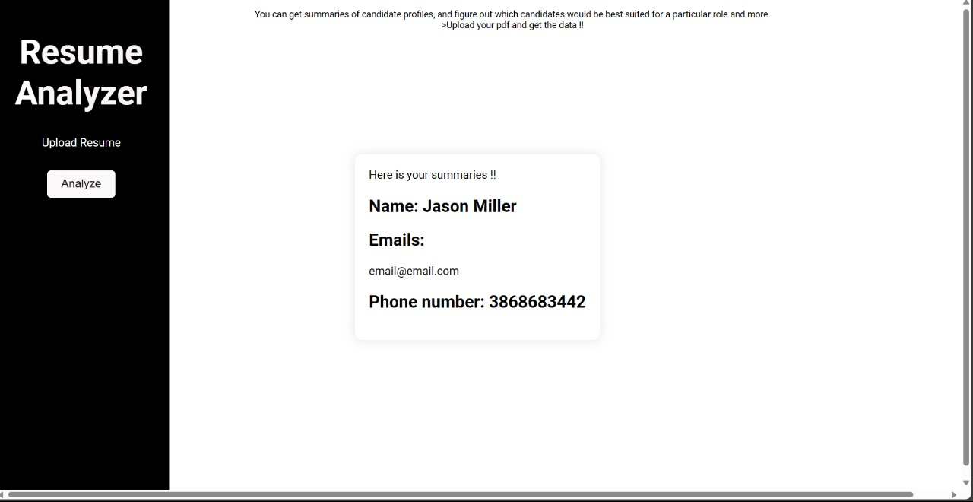
OUTPUT

Slide 11
REFERENCE PAPER
https://github.com/topics/resume-parser
https://nanonets.com/resume-parser
https://www.affinda.com/resume-parser
https://www.affinda.com/resume-parser
https://medium.com/google-cloud/streamlining-resume-parsing-with-google-document-ai-on-google-cloud-ai-platform-d702edc69f84
https://towardsdatascience.com/how-to-build-a-resume-parsing-tool-ae19c062e377

